Slide 1
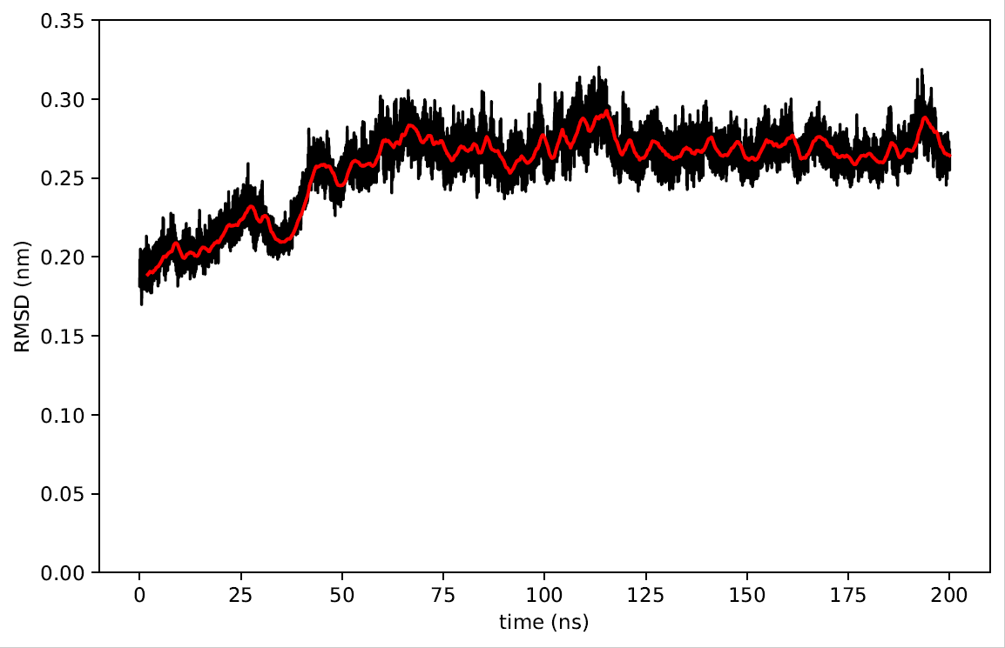
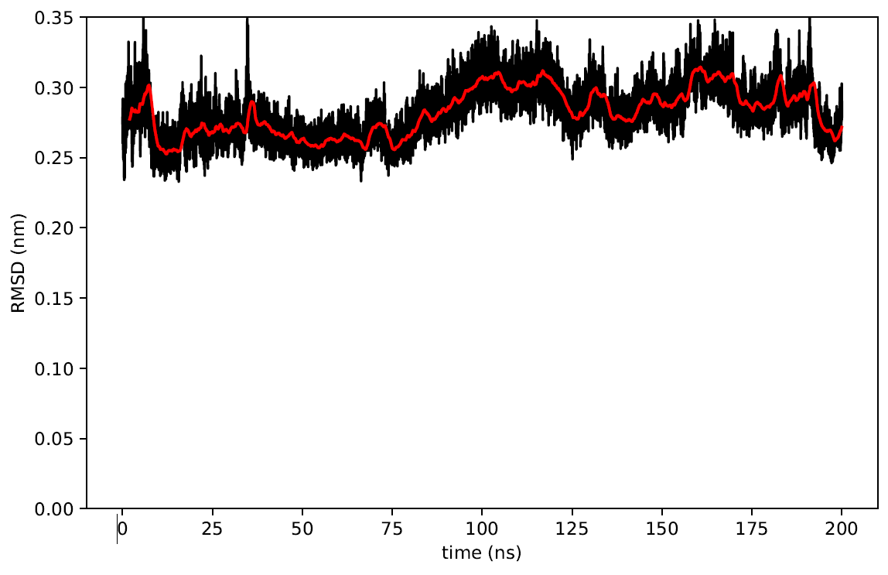
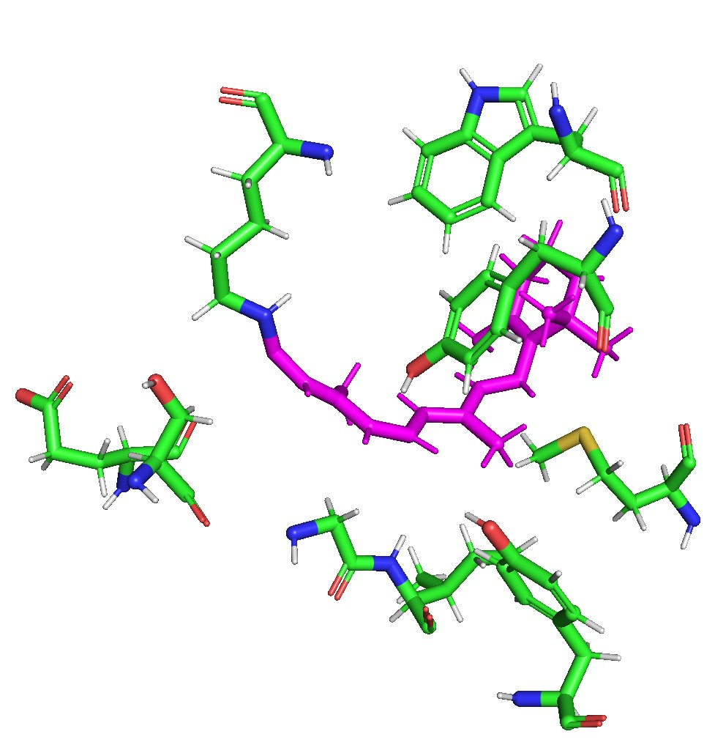
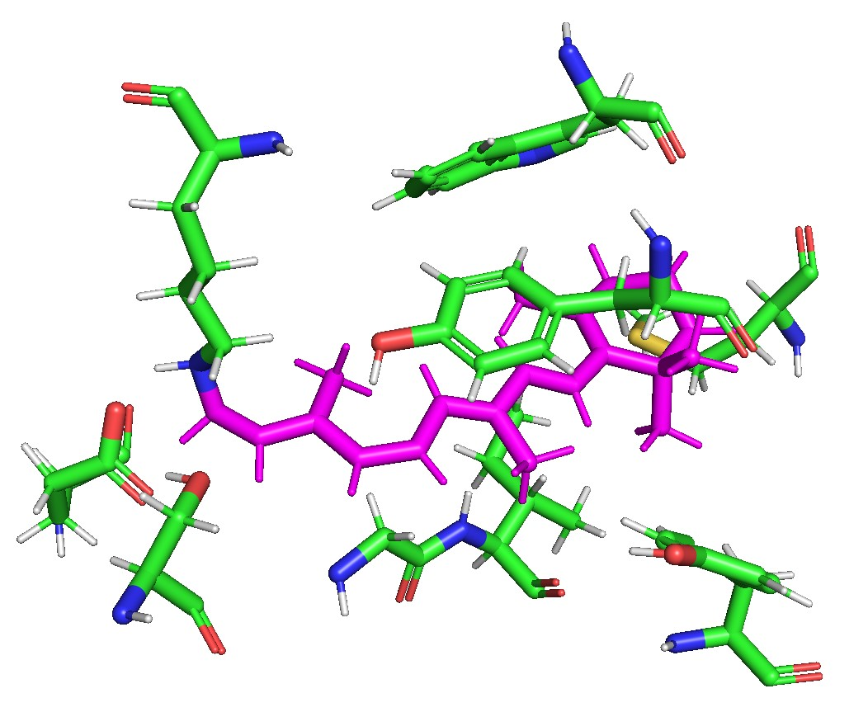
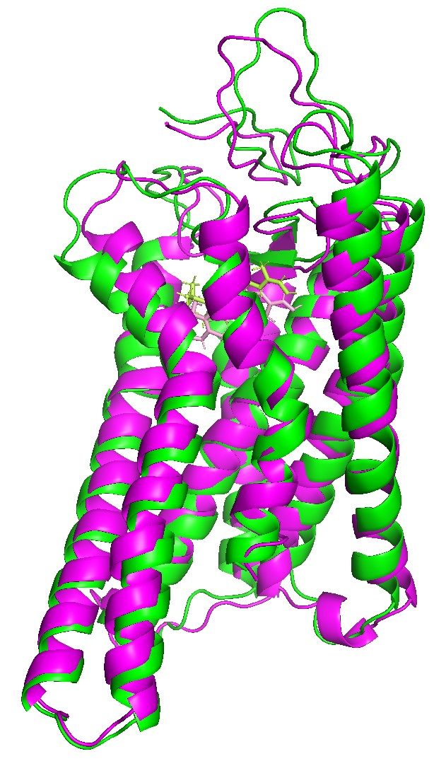
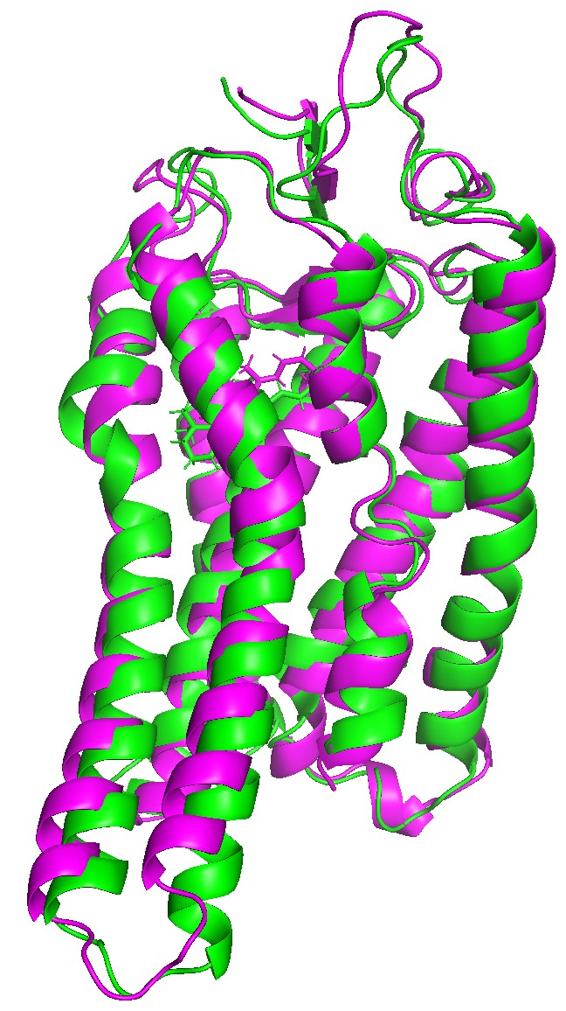
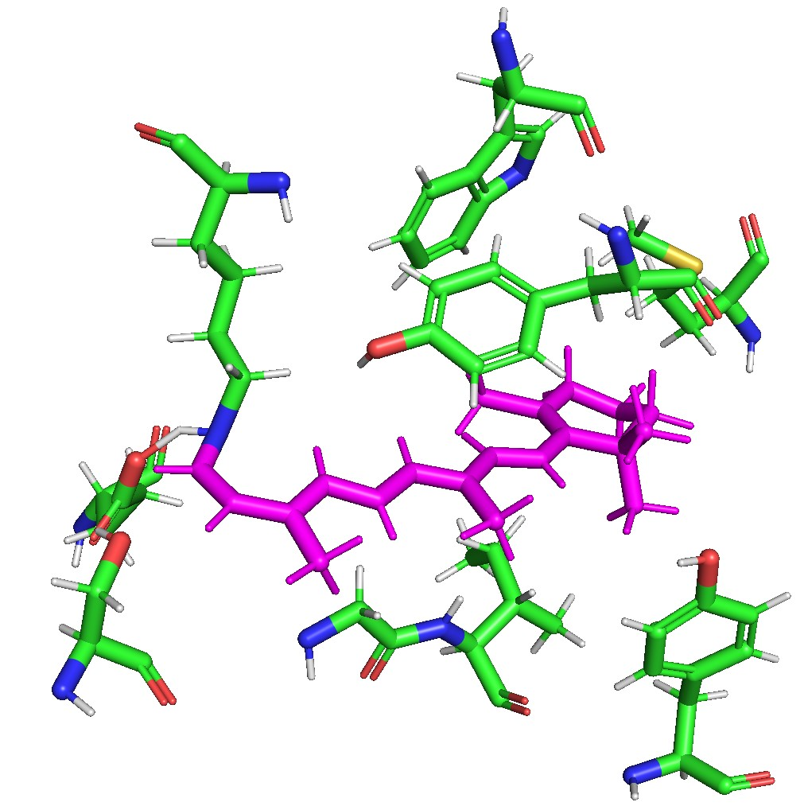
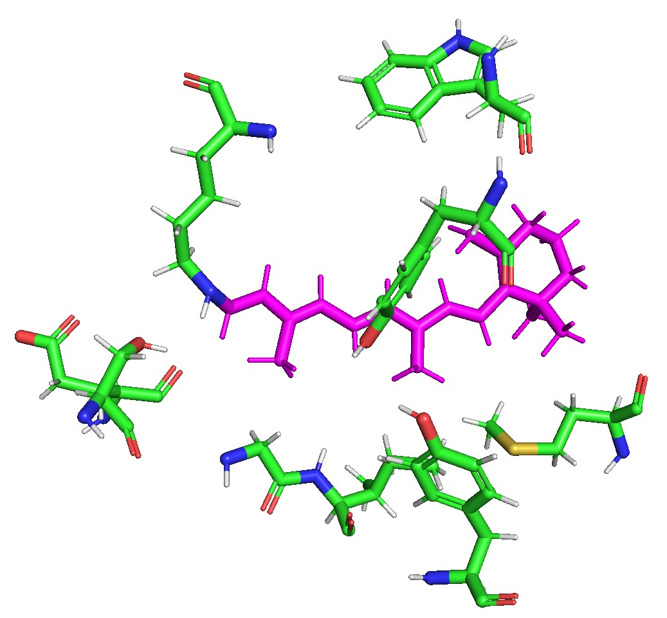
red: 2-ns running average
red: 2-ns running average
retinal in 11-cis state
retinal in 11-cis state
retinal in all-trans state, after 200ns
retinal in all-trans state, after 200ns
magenta: retinal in 11-cis state
green: retinal in all-trans state, after 200ns
magenta: retinal in 11-cis state
green: retinal in all-trans state, after 200ns
Native OPN2 (rhodopsin)
in explicit membrane and water environment
QTY-designed OPN2 (rhodopsin)
in explicit water environment

